Slide 1
BREXIT, THE E.U. AND THE RISE OF EUROPEAN POPULISM
Subtitle

Slide 2
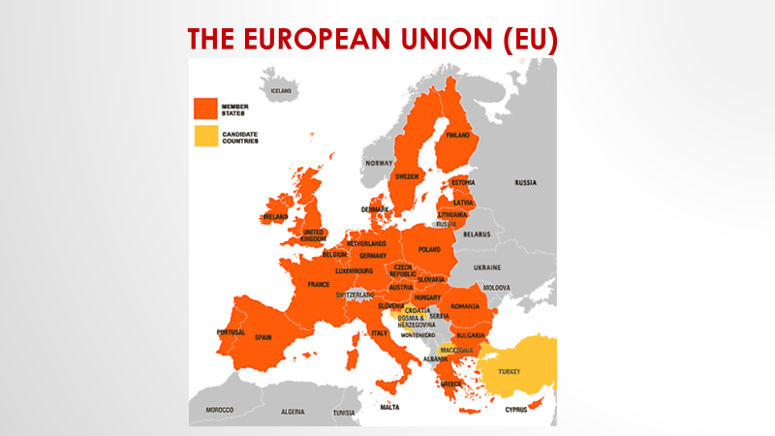

Slide 4
BREXIT

Slide 5
The United Kingdom

Slide 6
Why Voter Unhappiness?
Many Britons felt marginalized, powerless, unheard, simply discarded
As in the U.S., about 30% felt left behind (by globalization?), with stagnating wages and no standard of living improvement for years - while the top 1% had been getting richer
These people are bait for isolationists and xenophobes
Who in turn blame foreigners, migrants, refugees, transients for their country’s woes (the fault of the EU?), and demand that these people be deported

Slide 7
The EU Must Be To Blame!
Arguments heard in the UK in favor of leaving the EU:
The EU represents out of control economic regulation, labor laws, mandated social programs
Rules and regulations framed at the EU level
Rules that the Brexit voter didn’t want and couldn’t change
That no one in Britain asked for
And were enacted by officials whose names Brits didn’t know
People they never elected - and cannot remove from office
So much of what was thought of as British democracy no longer exists – it has been usurped by the EU !
60% (?) of British laws are made in Brussels
And Brits are paying Brussels £361m per week for the privilege!

Slide 8
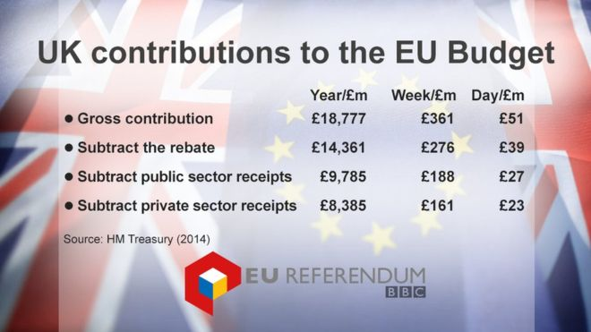

Slide 9
Other Reasons For Brexit?
Main reason - reaction of voters to Great Recession of 2008/9
PM David Cameron (Conservative/Tory) introduced austerity policies
Textbook answer was to cut taxes and increase government spending to boost the economy
UK chose the opposite in 2010 –
To raise taxes and reduce government spending in order to pay down debt incurred during the crisis
Which resulted in near-zero GDP growth
The xenophobic demagogues – the far right politicians and media hosts - saw this as an opportunity to achieve a different objective
Blame immigrants for the economic problems
See this as the fault of the EU
Solution? UK should become “independent” of the EU by leaving

Slide 10
Playing The Immigration Card
Far-right politicians have used immigration to scare people (who don’t understand their real economic predicament) into taking irrational action
As just noted, a more rational reason for voter disenchantment with the status quo would be the austerity policies of the Cameron government
Meant poor growth, little or no improvement in wages, and jobs being taken by immigrants who will work for lower wages
This is not just a UK problem – it is playing out all over the world, where people who feel ignored have a chance to cast a vote in the hopes of changing their circumstances
Unfortunately, too often that vision is not the dream of a better future but nostalgia for an exalted past whose strength lies in memory rather than reality

Slide 11
Plus Globalization - And Also We’re Really Angry At The Establishment
Brexit voters felt that the world around them (globalization?) had knocked them down a notch or two – through no fault of their own – leaving them feeling like strangers in their own land
Not unlike the French who follow ultra right-wing Marine LePen or the Dutch who follow Geert Wilders….or Americans who follow Donald Trump?
Each of these leaders have produced a “face” to help blame someone or something for the changing circumstances which affect all of us
Brexiteers trying to turn back the clock to a safer, sounder, more glorious time
The UK, with its new found freedom, will be able to foster the economic might and superiority it always believed it could - if it just went on its own?
No longer held down by the technocrats of Europe - and ‘all them immigrants’ ?

Slide 12
The Brexit Results
Turnout 72%
62% of Scotland voted to Remain
56% of Northern Ireland voted to Remain
60% of London voted to Remain
But only 47% of England and Wales voted to Remain
Which meant that 53% voted to Leave
So, overall, the result for the UK was:
Remain Leave

Slide 13
Remain leave

Slide 14
The Plunge Of The Pound!
USD exchange rate with the GBP

Slide 15
Eurozone Countries

Slide 16
Article 50

Slide 18
Post-Brexit Policy Changes
Economic and legal issues
New migration regime
Financial services regulation
Competition policy
Regional aid
State aid
Industrial policy
Agricultural policy
Higher education

Slide 19
THE EU: THE RISE OF POPULISM AND NATIONALISM

Slide 20
IN 1991, 71% of EU Citizens Considered Their Country’s Membership “A Good Thing.”

Slide 21
European Business Worries
Bigger problems on its plate than Brexit: After a decade of stagnation, the continent’s firms have suffered an alarming decline in their global clout
Of the 50 most valuable firms worldwide last year, only 7 were European (compared with 17 in 2006)
U.S had 31; China had 8
Of Europe’s 7 firms, 3 were Swiss (not an EU member), and one was really a Brazilian company

Slide 22
European Business Worries (Cont’d)
What went wrong? Five factors explain the slide:
Slow growth coupled with a strong US$
Focus on old industries like commodities, steel and banking
Too much focus on cutting deals in emerging markets when the rest of the world was consolidating
Managers’ attitude toward shareholder value could explain differences in market value between Europe and America
Europe needs to restrain its nationalistic instincts and temper its tough approach to anti-trust concerns

Slide 25
French Presidential Election

Slide 26
“Russia is a natural ally of Europe” [Le Pen]
“My Dear Vladimir” [Fillon]

Slide 27
Russian Interference in the French and German Elections

Slide 32
IT’LL NEVER HAPPEN HERE!

Slide 36
CONCLUSION

Slide 37
Populism and Globalization
Rise of populism has certainly shaken global elites out of their complacency
Belatedly thinking about policies to help those left behind by economic changes of recent decades
Will be some protectionist measures adopted regarding trade agreements
Although trade deficits can at most be blamed for manufacturing job losses of 1.5% of the workforce (most losses due to technological change)
Governments are way overdue to think about policies that address the plight of those disadvantaged by globalization and technological and other domestic changes since the 1970s
Cuts in corporation taxes are useless, and even counterproductive
Much more needs to be done to identify effective policies, and then to generate the political will to put them in place

Slide 38
DISCUSSION

